Slide 1



To develop a CNN model to classify images of plastic waste

Slide 2

Learning Objectives
Technical Learning Objectives:
Understand Convolutional Neural Networks (CNNs)
Data Preprocessing
Image Classification Fundamentals
Model Building and Training
Hyperparameter Tuning
Evaluation and Validation
Model Deployment
Domain-Specific Learning Objectives:
Plastic Waste Categorization
Environmental Impact Awareness
Environmental Impact Awareness
Environmental Impact Awareness:
Literature Review:
Collaborative Skills:
GOAL
Source :
www.freepik.com/

Slide 3
Tools and Technology used
Programming Languages
Development Environments
Machine Learning Frameworks and Libraries
Image Processing Tools
Data Annotation Tools
Data Storage and Management
Model Training and Optimization
Model Training and Optimization
Visualization Tools
Version Control
Hardware (Optional)

Slide 4
Methodology
Problem Definition
Data Collection
Data Preprocessing
Exploratory Data Analysis (EDA)
Model Development
Model Training
Model Evaluation
Model Optimization
Model Deployment
Monitoring and Maintenance
Documentation and Reporting

Slide 5
Problem Statement:
Problem Statement:
Plastic waste is a significant environmental challenge, with improper disposal and inefficient recycling processes contributing to pollution and harm to ecosystems. Manual sorting of plastic waste is time-consuming, error-prone, and inefficient, making it difficult to achieve effective waste management and recycling.
The goal of this project is to develop a Convolutional Neural Network (CNN) model that can automatically classify images of plastic waste into predefined categories (e.g., PET, HDPE, LDPE, etc.). This system aims to enhance the automation of waste sorting processes, improve recycling efficiency, and promote sustainable waste management practices.
Key Challenges:
Diverse Plastic Types: Plastic waste varies in appearance, texture, and shape, making classification challenging.
Real-World Conditions: Images may be affected by environmental factors such as lighting, background clutter, and occlusions.
Dataset Availability: A sufficiently large and diverse dataset of labeled plastic waste images is required for effective model training.
Objective: To build a robust and accurate CNN model that can classify plastic waste images with high precision, enabling its integration into automated waste management

Slide 6
Solution:
Collect Pictures: Gather pictures of different types of plastic waste (like bottles, bags, and containers).
Organize and Label: Sort the pictures into categories (e.g., "Bottles," "Bags").
Prepare the Images: Resize all pictures to the same size (e.g., 128x128). Add more variety by flipping or rotating them.
Build a Model: Use a ready-made image recognition tool (like a pre-trained CNN model such as ResNet or MobileNet) to identify plastics.
Train the Model: Teach the model with your labeled pictures and check its progress on test pictures.
Test the Model: Try the model with new pictures to see if it correctly identifies the type of plastic.
Use it in Real Life: Deploy this tool in recycling plants or share it with people to help with plastic waste sorting.

Slide 7
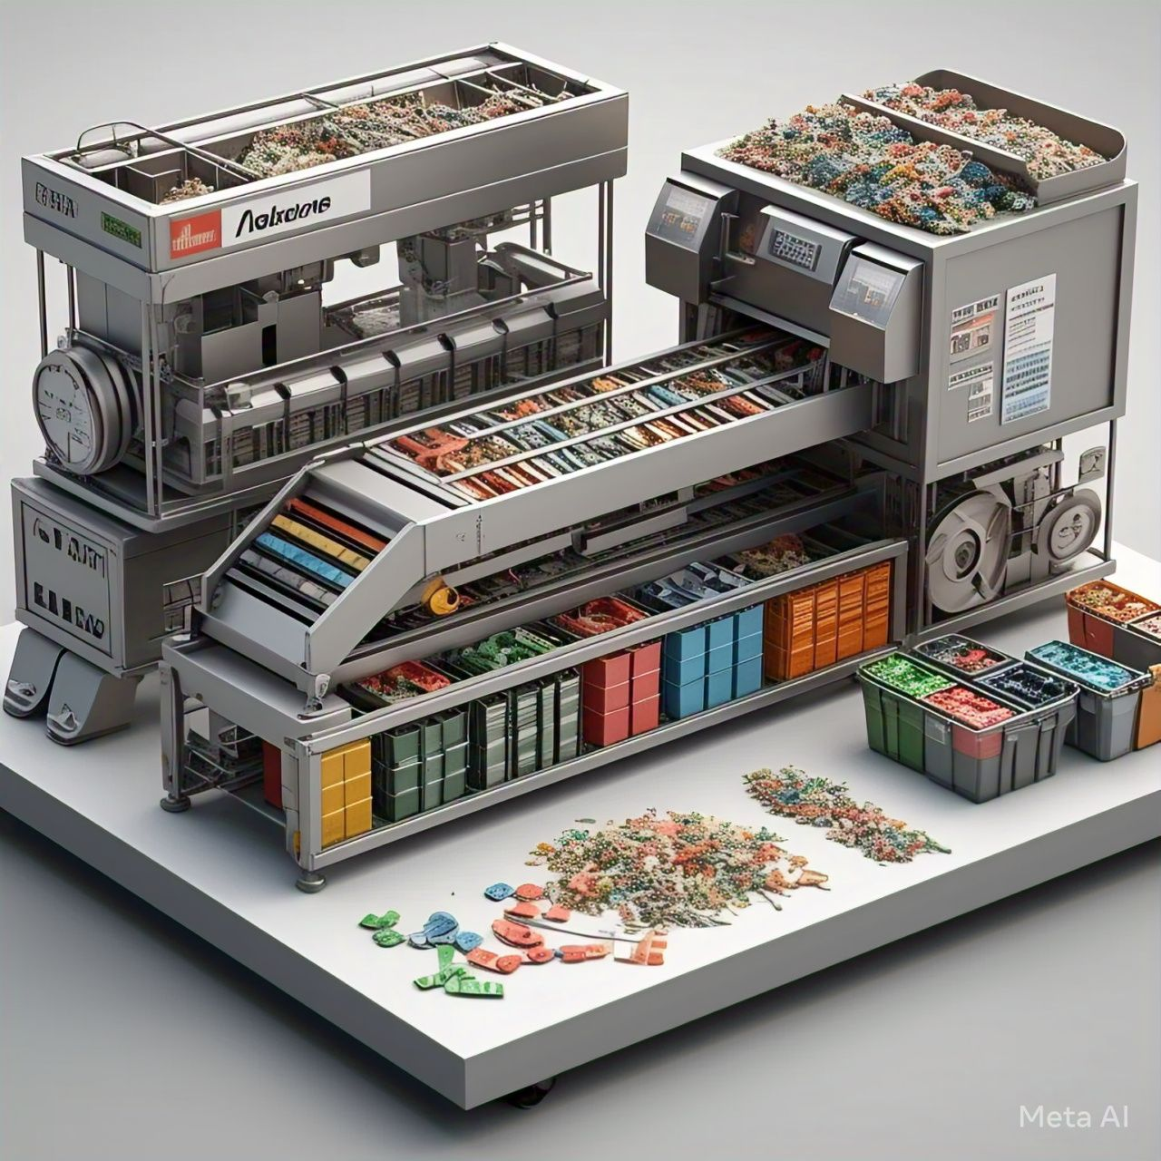
Screenshot of Output:

Slide 8
Conclusion:
The development of a CNN model to classify images of plastic waste is a transformative approach to tackling the growing environmental challenge of plastic waste management. By automating the classification process, this solution eliminates the inefficiencies of manual sorting, improves recycling rates, and reduces the environmental footprint of plastic waste.
Through the use of deep learning techniques, the model can accurately recognize and categorize various types of plastic, even under challenging real-world conditions. Integrating this solution into waste management systems, recycling plants, or mobile applications can lead to more efficient recycling workflows and raise awareness about proper waste segregation.
This project demonstrates how advanced technology, such as Convolutional Neural Networks, can drive innovation in environmental sustainability. By bridging the gap between technology and waste management, it offers a scalable, efficient, and impactful solution to one of the most pressing issues of our time, paving the way for a cleaner and healthier planet.

